Slide 1

SQL RESTAURANT & CONSUMER ANALYSIS
Using SQL for Data Exploration and Analysis
Name : Shaik Rahamthulla
Enrollment No : 81021201834
  Course : Data Analytics Training Program

Slide 2
About me
B.Tech in Artificial Intelligence & Machine Learning, Sri Vasavi Engineering College (2025), CGPA 7.83/10
Hands-on experience in Python, SQL, and Power BI through academic and training projects in data analysis, web scraping, and application development
Fresher — currently pursuing the Data Analytics Training Program at Innomatics Research Labs (since March 2026)
Certifications: ServiceNow CSA & CAD, Microsoft Fabric Data Engineer Associate, Microsoft Fabric Analytics Engineer Associate, NPTEL Machine Learning
LinkedIn: https://www.linkedin.com/in/sk-ramthu-23r
GitHub: https://github.com/Ramthu-info

Slide 3

Agenda
Introduction
Objective of the Project
Dataset Overview
Database Structure
SQL Concepts Used
Key Analysis Questions / Use Cases
Advanced SQL Analysis
Key Findings
My Experience / Challenges
Key Learnings
Conclusion
Q&A

Slide 4
INTRODUCTION
This project focuses on analyzing restaurant and consumer data using SQL. The dataset contains information about consumers, their food preferences, restaurants, cuisines, and ratings. The data was organized into related tables using Consumer_ID and Restaurant_ID. The main purpose is to understand consumer preferences, restaurant details, and rating patterns through different SQL queries. This project also helped me gain practical experience in SQL data analysis, problem solving, and working with multiple related tables, while improving my understanding of databases and writing SQL queries for different analysis requirements.

Slide 5
OBJECTIVE OF THE PROJECT
Main Objective
The main objective of this project is to use SQL to explore restaurant and consumer data and find useful information from it.
Project Goals
Understand the structure of the given data.
Create relationships between different tables.
Analyze consumer information and food preferences.
Study restaurant details and available cuisines.
Analyze ratings given by consumers.
Use SQL to answer different analysis questions.
Practice both basic and advanced SQL concepts.
Improve my ability to solve data-related problems using SQL.

Slide 6
DATASET OVERVIEW
The project data is divided into five files, and each file provides a different part of the restaurant and consumer information.
Consumers: This file contains consumer details such as Consumer ID, city, location, age, occupation, marital status, children, smoking status, transportation method, and budget.
Consumer Preferences: This file connects consumers with their preferred cuisines. It contains the Consumer ID and Preferred Cuisine, showing the types of food each consumer likes.
Restaurants: This file contains information about restaurants, including Restaurant ID, restaurant name, location, price, alcohol service, smoking allowed, franchise status, area, and parking.
Restaurant Cuisines: This file connects restaurants with the cuisines they serve. It contains the Restaurant ID and Cuisine, showing the different food types available at each restaurant.
Ratings: This file records the ratings given by consumers to restaurants. It contains Consumer ID, Restaurant ID, Overall Rating, Food Rating, and Service Rating.

Slide 7
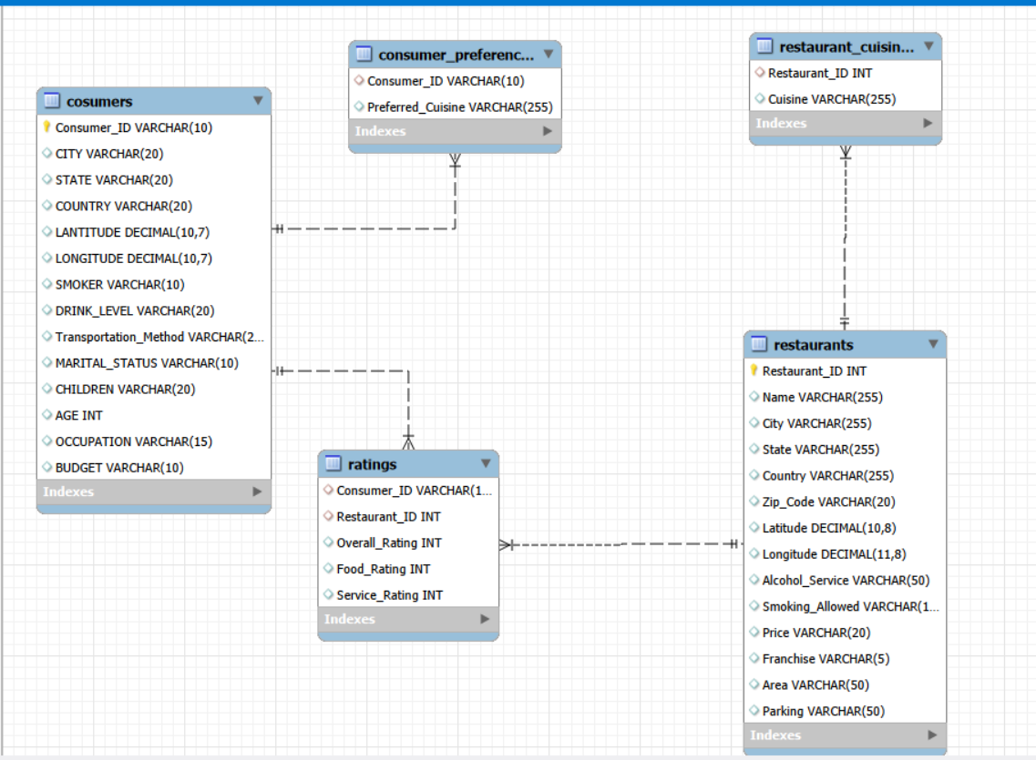
DATABASE STRUCTURE
he project contains multiple tables that are connected through common IDs.
Main Connections
Consumers
→ Consumer_ID → Consumer Preferences→ Ratings
Restaurants
→ Restaurant_ID → Restaurant Cuisines→ Ratings
Important Relationships
Consumer_ID connects consumer details with preferences.
Consumer_ID also connects consumers with their ratings.
Restaurant_ID connects restaurant details with cuisines.
Restaurant_ID also connects restaurants with their ratings.

Slide 8
SQL ANALYSIS & CONCEPTS USED
SQL Concepts Used
Basic SQL
SELECT
WHERE
ORDER BY
GROUP BY
HAVING
JOINs & Subqueries
INNER JOIN ,LEFT JOIN,RIGHT JOIN
Subqueries
IN
NOT IN
EXISTS
Advanced SQL
CTEs
Window Functions
Views
Stored Procedures
Derived Tables
Window Functions
ROW_NUMBER()
RANK()
LEAD()
AVG() OVER()

Slide 9
KEY ANALYSIS QUESTIONS
Key Analysis Questions / Use Cases
Consumer Analysis
Find consumers from specific cities
Identify student consumers who smoke
Analyze consumer demographics
Find consumers based on cuisine preferences
Compare consumers based on their ratings
Restaurant Analysis
Find medium-priced restaurants
Find restaurants offering wine and beer
Identify franchise restaurants
Find highly-rated restaurants
Identify restaurants serving Mexican cuisine

Slide 10
KEY ANALYSIS QUESTIONS
Key Analysis Questions / Use Cases
Rating Analysis
Find restaurants rated in specific cities
Find consumers with food ratings below the average
Identify consumers who rated non-Italian restaurants
Compare food and service ratings
Find restaurants performing above the average
Advanced Analysis
Rank restaurants based on ratings
Analyze rating patterns within restaurants
Find top preferred cuisines
Compare consumer and restaurant performance
Use multiple tables to answer complex questions

Slide 11
OVERALL KEY FINDINGS
From the analysis questions, the project helps us understand:
Consumer Insights
Consumer information can be studied using age, occupation, city, budget, and preferences.
Consumer preferences can be connected with their restaurant ratings.
Different consumer groups can be identified using SQL conditions.
Restaurant Insights
Restaurants can be compared based on price, cuisine, location, franchise status, and services.
Restaurant ratings can be analyzed along with their other details.
Rating Insights
Overall, Food, and Service ratings can be compared.
Average ratings can be used to compare restaurant performance.
Ranking can help identify highly-rated restaurants.

Slide 12
MY EXPERIENCE / CHALLENGES
Understanding Tables
At first, understanding how the tables were connected was difficult.
I solved it by checking the common IDs and relationships.
Using JOINs
Joining multiple tables was a little challenging.
I practiced different JOINs and checked the results step by step.
Learning Advanced SQL
CTEs and Window Functions were new to me.
I practiced simple examples first and then used them in the project.
Writing Complex Queries
Some questions needed multiple tables and conditions.
I broke the questions into small steps and built the queries one by one.

Slide 13
CONCLUSION
Conclusion
The project helped me analyze restaurant and consumer data using SQL.
I worked with multiple related tables and used different types of JOINs.
I used aggregation, subqueries and filtering to answer analysis questions.
I applied advanced SQL concepts such as CTEs and Window Functions.
I also worked with Views and Stored Procedures.
The analysis helped identify patterns in consumer preferences, restaurant performance and ratings.
Overall Learning
This project helped me understand how SQL can be used to analyze real-world data and generate useful insights.

Slide 14

THANK YOU

